Slide 1
Efficient Classification Model Of Web News Documents using Machine Learning Algorithms
Presented By: Kevin Gyorick
Supervisor
Aos Mulahuwaish, PhD
Department of Computer Science and Information Systems
Saginaw Valley State University
Notes:
Hello my name is Kevin Gyorick and my supervisor is Dr. Aos we are with the department of Computer Science and Information Systems here at SVSU. I am here today to present our <TITLE>.

Slide 2
Introduction
We have witnessed that more applications are moving to web page based approaches instead of desktop applications.
However, there is a common issue with this approach, the processing of huge amounts of information or BigData.
Despite having to handle Big-Data, web applications are the most accessible application for users to get updated information.
The contribution of this presentation is to demonstrate how features like article content using classifiers can reduce computation strain on time and space complexity.
Notes:
Point 1: In particular, services like shopping, billing, communication, and transportation can all be done with an internet browser or web page application instead of a sizeable application that is installed onto the device.
Point 2: Sites for serving web news have this issue since they have to serve thousands of users in short periods of time and have many articles to keep organized for easy filtering.
Point 3: Being able to load an application in seconds without installation attracts many users resulting in the need for huge amounts of computational power to serve users in seconds with the results they were expecting.

Slide 3
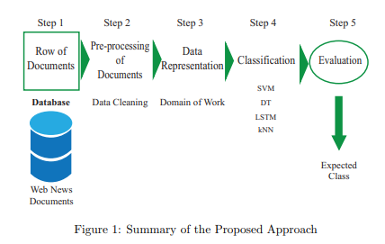
The Proposed Method
Notes:
Our proposed method consists of five steps. First we need to collect a list of web news document that we want to use. Then those documents will go through some pre processing. Next we need to be able to represent that data to the classifier. Finally we can use a classifier on the document and evaluate how well it performed.

Slide 4
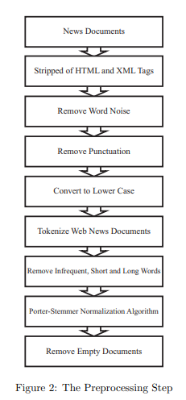
Preprocessing Step
This section is significant in order to make the dataset ready for classification.
Documents were processed using the following steps as shown in figure 2.
Notes:
The documents were stripped of HTML and XML tags
Words that are considered noise were removed such as “is”, “the” and “it”
Punctuation and special symbols were also removed
All text was converted to lower case
the documents are tokenized turning the articles into arrays of meaningful words so the frequency of each word can be calculated
The infrequence words that appear two or fewer times are then removed along with short words of two or fewer letters and long words.
The words are then processed by Porter-Stemmer normalization algorithm [12], which removes common morphological and inflexional endings from English words leaving the stem of the word for example the words “running” and “runner” would become the word “run”.
After the above process, some documents will become empty, so they are removed from the array.

Slide 5
Classification
The classifiers we used were
Support Vector Machine (SVM)
Decision Tree (DT)
Long-Short Term Memory (LSTM)
K-Nearest Neighbor (kNN)
These techniques require two datasets the training dataset used when training the classifier and the test dataset used to test the accuracy of the classifier after training.

Slide 6
Support Vector Machine
SVMs work by graphing the dataset where the number of features equals the dimensions of the graph.
The dataset points are then separated by hyperplanes.
If there is not a best fit hyperplane for the dataset, the dataset must be scaled to the next dimension using a kernel function
Notes:
Point 2: which in the 2D sense with two classes consist of three parallel lines, two of these lines are known as the support vectors they boarder the closest data point(s) between classes. The last line marks the midpoint between the two support vectors. The hyperplane with the greatest distance between the two support vectors is the best fit.
Point 3: Popular kernel functions include polynomial as in Equation 1 and gaussian as in Equation 2. But there are many others. (radial basis function (RBF), laplace RBF, sigmoid, anove RBF, etc.)

Slide 7
Decision Tree
A DT builds a flow chart diagram that looks like a tree and branches off at every decision or variable.
The topmost node of the tree is known as the root node, the tree’s creation originates at the root node and is built in a top-down fashion.
Entropy shown in Equation 3, is used to measure how unpredictable a decision is within the tree.
Information gain is used to measure the reduction of uncertainly when additional nodes are used before the given node, Equation 4. The set of nodes that provide the most information gain are used.
Decision trees are prone to overfitting since this above process is repeated on every branch of the tree.
Notes:
Point 3: 1 being very unpredictable, a 50% chance and 0 being a guarantee, either a 0% or 100% chance. Where pi is the probability of a class i and c is the total classes.

Slide 8
Long Short-Term Memory
LSTM specializes in text classification since the classifier can learn longterm dependencies between the text.
The LSTM classifier is a form of recurrent neural network or RNN, which is a layered network that uses the previous outputs for the inputs of the next layer.
LSTM has feedback connections allowing it to work with sequences of data instead of just single data points.
An LSTM node consists of a cell, input gate, output gate, and forget gate. The cell is what remembers values over a time interval and the three gates regulate how the information will flow through the cell.

Slide 9
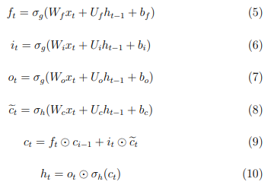
The following Equations 5 - 10 are used in the creation of an LSTM with a forget gate.
Where W and U are matrices containing the weights for the inputs and recurrent connections.
xt is the input vector unit
ft is the forget activation vector
it is the input activation vector
ot is the output activation vector
ht is the output vector unit
ect is the cell input activation vector
ct is the cell state vector.
σg and σh are the activation functions sigmoid and hyperbolic tangent, respectively.
Notes:
Point 1: If you are interested, below is a list of the meaning of each variable.

Slide 10
K-Nearest Neighbors
The kNN technique works by using documents from the training dataset after they are preprocessed to build its model.
The model uses the Euclidian distance equation shown in Equation 11.
The Euclidian distance is calculated between a new document from the test dataset that was also preprocessed, and all of the training data points.
After all the Euclidean distances are calculated for the new news document they are sorted from the smallest distances to the largest.
The k nearest data points are selected based on the distance and the mode class in the k points is used as the prediction.
The model is recreated many times with different values for k to see which k will produce the fewest errors when new data is introduced to the model.

Slide 11
Implementation and Testing of the Proposed Method

Slide 12
The Dataset
The dataset being utilized to train the classification algorithms is the news aggregator dataset provided by “Center for Machine Learning and Intelligent Systems” – “Information system and computer science” – “University of California, Irvine”.
The dataset spans the period from October 4, 2014, to October 8, 2014. The news articles are in four different clusters that represent the content of the articles. The Artificial Intelligence Lab at the Faculty of Engineering, Roma Tre University – Italy originally provided the dataset [13].
The dataset provides 422,937 news articles in four different categories, entertainment, science and technology, business, and health.
For the experiment 25,000 news articles were randomly chosen from all categories and for classification purposes divided into two subsets. The training dataset which includes 90% or 95% of the random dataset and the test dataset containing the remaining data in the random dataset.

Slide 13
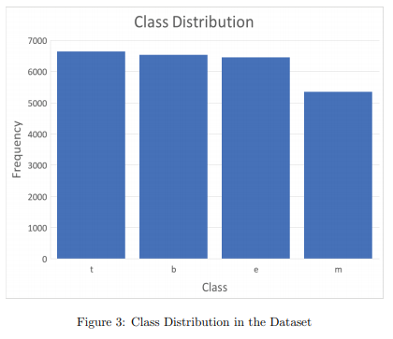
Dataset Distribution
Figure 3 shows the distribution of the four different categories in the dataset used in the experiment. “b” denotes the business category, “e” denotes entertainment, “m” denotes health and “t” denotes science and technology

Slide 14
Terms
A true positive is a correctly identified member of a class that is labeled as positive
A false positive is an incorrectly identified member of a class that is labeled as positive.
A true negative is a correctly identified member of a class that is labeled as negative
A false negative is an incorrectly identified member of a class that is labeled as negative

Slide 15
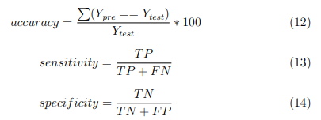
measures
Accuracy is how close the classification algorithm is to the desired results. To measure accuracy of the different classification algorithms, Equation 12 is used. Where Ypre is the classification’s predictions for the test-dataset documents and Ytest is the correct predictions for the test-dataset documents.
Sensitivity is a percentage that represents the true positive rate the classification algorithm achieved. Sensitivity is calculated using Equation 13, where TP is the total true positives and FN is the total false negatives.
Specificity is a percentage that represents the true negative rate the classification algorithm achieved. Specificity is measured using Equation 14 where TN is the total true negatives and FP is the total false positives.

Slide 16
confusion matrix and ROC Curves
The confusion matrix is used to demonstrate the preferred result against the predicted result.
Each column of the matrix represents samples in the predicted class while each row represents samples in the actual class.
Receiver Operating Characteristics (ROC) curves are also used throughout the article to demonstrate a true positive rate against the false positive rate at various thresholds.
The dataset is being organized into four classes instead of two so in order to use ROC curves the one verse all approach is used.
The area under a ROC curve (AUC) and accuracy of a classification technique are good indicators for comparison.

Slide 17
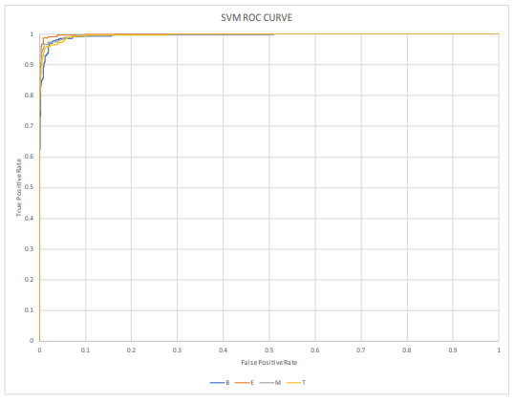
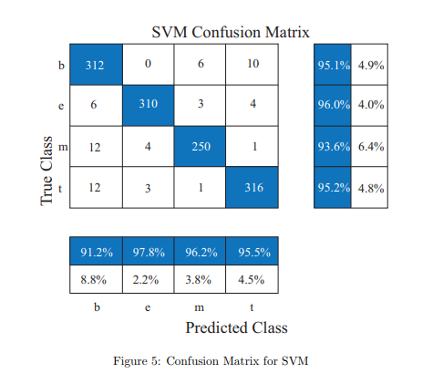
Results: Support vector machine
Notes:
Support vector machine was implemented using MATLAB R2020a’s fitcecoc function. The SVM achieved an accuracy of 95.04% making SVM the leading classification technique for the dataset. Since SVMs have no trouble handling large feature datasets. The ROC curve as seen in Figure 4 has an average area under the curve (AUC) of 99.4% for the SVM technique. Figure 5 shows the SVM is classifying most of the dataset correctly with a high average sensitivity of 94.97% and an average specificity of 5.03%. Health has the highest false negative rate at 6.4%.

Slide 18
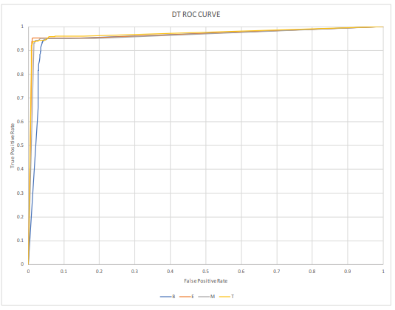
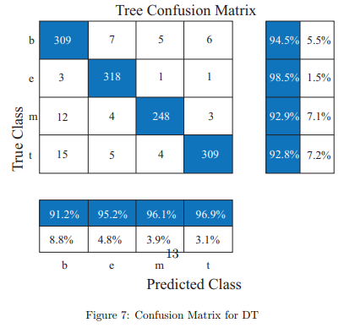
Results: decision tree
Notes:
Decision tree was implemented using the MATLAB fitctree function. DT achieved an accuracy of 94.72% making DT the second best solution. The ROC curve in Figure 6 has an average AUC of 97.78% for the decision tree technique. Figure 7 shows the DT is classifying the dataset at an average sensitivity of 94.68% and an average specificity of 5.32%. Technology has the highest false negative rate at 7.2% just 0.1% higher than health.

Slide 19
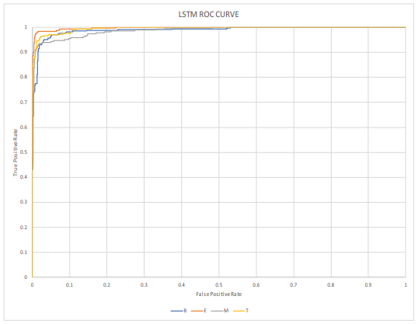
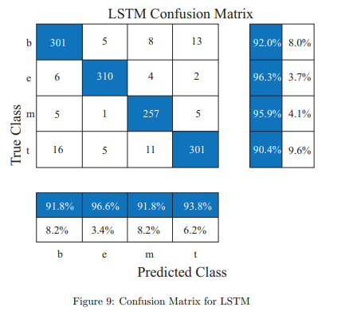
Results: long short-term memory
Notes:
The long short-term memory classifier was implemented with the MATLAB trainNetwork function. LSTM achieved an accuracy of 93.52% making LSTM the third best solution. The ROC curve as seen in Figure 8 has an average AUC of 99.3% for the LSTM technique. Figure 9 shows the LSTM classifier achieved an average sensitivity of 93.65% and an average specificity of 6.35%. Technology has the highest false negative rate at 9.6%.

Slide 20
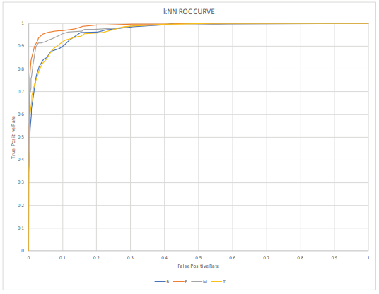
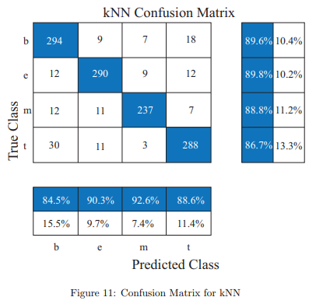
Results: k-nearest neighbors
Notes:
K-nearest neighbors was implemented using the MATLAB fitcknn function. kNN achieved an accuracy of 88.72% making kNN the worst solution. The ROC curve in Figure 10 has an average AUC of 97.99% for the kNN technique. Figure 11 shows the underperformance of the kNN classifier with only an average sensitivity of 88.73% and an average specificity of 11.27%. Technology was misidentified the most with a false negative rate of 13.3%.

Slide 21
Conclusion
After recognizing the daily impact web applications have on users and their popularity, related studies were discussed to find the gap in this area of research.
In the proposed method section, the preprocessing step was explained, and the arithmetic used to create the machine learning classifiers.
In the implementation section, the study demonstrated a more accurate and less time and space complexity approach to using machine learning classifiers to sort Big-Data for faster filtering.
The research compared four classifiers K-Nearest Neighbors (kNN), Support Vector Machine (SVM), Decision Tree (DT), and Long Short-Term Memory (LSTM). SVM coming out on top with the best accuracy of 95.04% and kNN with the worst at 88.72%.
Web mining in combination with classification has become a valued research topic over recent years. Existing solutions fulfill the needs of most web applications. However, existing solutions require a huge amount of computation power, so the proposed approach works on reducing space and time complexity.
The results of the top classifiers demonstrated good accuracy, a reduction in time needed for the training and testing phases of classification (time complexity), and reduction of total documents (space complexity).

Slide 22
Publication
Published in the Computers & Security Journal - Elsevier, Impact Factor 3.579
Aos Mulahuwaish, Kevin Gyorick, Kayhan Zrar Ghafoor, Halgurd S Maghdid, Danda B Rawat. Efficient Classification Model of Web News Documents using Machine Learning Algorithms. Computers & Security - Elsevier, 2020 https://www.sciencedirect.com/science/article/pii/S0167404820302790
Notes:
The work we have presented today has been published in the Computers & Security Journal, Elsevier that has an impact factor of 3.579

Slide 23
acknowledgment
This work was in part supported by Saginaw Valley State University.

Slide 24
Future work
Time and user-visiting information can be used in product mining for a web application to recommend products the customer is more likely to buy.
An admin panel can be created for the classifiers that will show the application admin the results of the classifier at a glance right on the site they’re managing.
Other classification techniques can be tested for classifying web news to check if they can further reduce space and time complexity along with other advantages over the classifiers tested here.
Notes:
The experiment along with other web mining research provides proof that classifiers are affective at sorting web news.
However, there is more research in web mining to be desired. For example…

Slide 25
Current work
Currently we are working on improving drone localization.
Our goal is to allow drones to communicate with other nearby drones through technologies such as WiFi Direct to help prevent collision of autonomous and managed drones.
We hope to present our findings at the next showcase

Slide 26
references
[1] Smita and Priti Sharma. Use of data mining in various field: A survey paper. IOSR Journal of Computer Engineering, vol. 16, no. 3, pp. 18-21 (2014).
[2] F. S. Gharehchopogh, S. R. Khaze, and I. Maleki. A new approach in bloggers classification with hybrid of k-Nearest neighbor and artificial neural network algorithms. Indian J. Sci. Technol., vol. 8, no. 3, pp. 237–246 (2015).
[3] T. Broxton, Y. Interian, J. Vaver, and M. Wattenhofer. Catching a viral video. J. Intell. Inf. Syst., vol. 40, no. 2, pp. 241–259 (2013).
[4] P. Lopes and B. Roy. Dynamic recommendation system using Web usage mining for e-commerce users. Procedia Comput. Sci., vol. 45, pp. 60–69 (2015).
[5] M. Khosravi and M. Tarokh. Dynamic mining of users interest navigation patterns using naive Bayesian method. Proceedings of the 2010 IEEE 6th International Conference on Intelligent Computer Communication and Processing, pp. 119-122 (2010).
[6] B. Devi, Y. Devi, B. Rani, and R. Rao. Design and implementation of web usage mining intelligent system in the field of e-commerce. Procedia Engineering, vol. 30, pp. 20-27 (2012).
[7] S. Kaur and E. M. Rashid. Web news mining using back propagation neural network and clustering using K-means algorithm in big data. Indian J. Sci. Technol., vol. 9, no. 41, pp. 1–8 (2016).
[8] S. Bora. Data mining and ware housing. IEEE, pp. 1-5 (2013).

Slide 27
references
[9] A. Akilan. Text mining: challenges and future directions. IEEE, pp. 1679-84 (2015).
[10] J. Tom´as, J Bataller, F. Casacuberta, and J. Lloret. Mining Wikipedia as a parallel and comparable corpus. Language Forum, vol. 34, no. 1 pp. 123-136 (2008).
[11] J. Tom´as, E. S´anchez-Villamil, F. Casacuberta, and J. Lloret. WebMining: An unsupervised parallel corpora web retrieval system. Proceedings from the Corpus Linguistics Conference (2005).
[12] P.-H. Chen, H. Zafar, M. Galperin-Aizenberg, and T. Cook. Integrating natural language processing and machine learning algorithms to categorize oncologic response in radiology reports. J. Digit. Imag., vol. 31, no. 2, pp. 178–184 (2018).
[13] F. Gasparetti. Modeling user interests from web browsing activities. Data Mining Knowl. Discovery, vol. 31, no. 2, pp. 502–547 (2017).

Slide 28
Questions
Contact
Kevin Gyorick: kpgyoric@svsu.edu

